Slide 1
Scientific Machine Learning for Modeling, Optimization, and Control of Dynamical Systems
Ján Drgoňa
Associate Professor Civil and Systems Engineering Department The Ralph O'Connor Sustainable Energy Institute (ROSEI)
Data Science and AI Institute (DSAI)

Slide 2
Course Syllabus
Week 1: Introduction to Scientific Machine Learning (SciML)
Week 2: Preliminaries and Introduction to differentiable programming
Week 3: Physics-informed neural networks (PINNs)
Week 4: Neural ordinary differential equations (NODEs)
Week 5: Neural differential equations with constraints
Week 6: Learning to optimize (L2O)
Week 7: Feasibility restoration methods in L2O
Week 8: Differentiable control
Week 9: Safety filters for learning-based control
Week 10: SciML applications
Week 11: Project evaluation with presentations

Slide 3
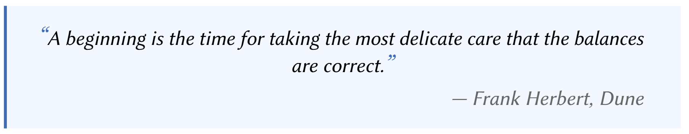
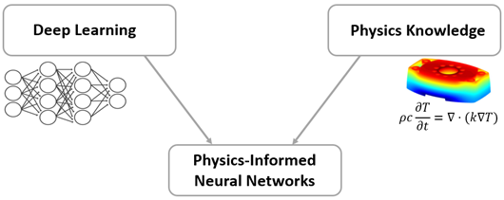
Physics-Informed Neural Networks (PINNs)
https://www.mathworks.com/discovery/physics-informed-neural-networks.html
M. Raissi, et al., Physics-informed neural networks: A deep learning framework for solving forward and inverse problems involving nonlinear partial differential equations, Journal of Computational Physics, 2019

Slide 4

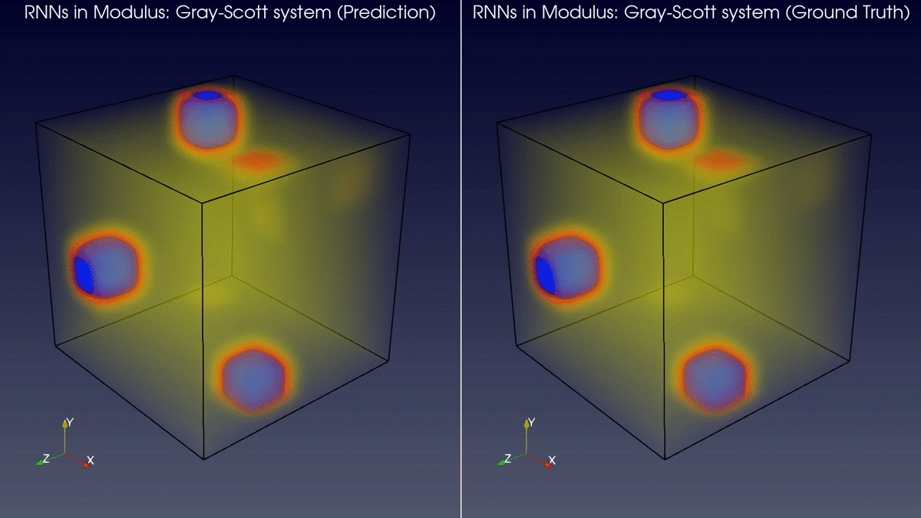
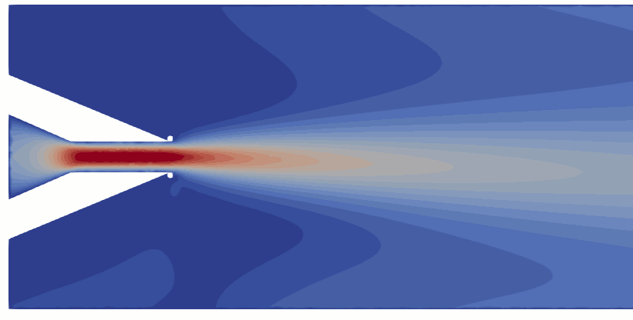
Applications of Physics-Informed Neural Networks
Training neural networks as PDE solutions
Application: Parameter estimation from data
M. Raissi, et al., Physics-informed neural networks: A deep learning framework for solving forward and inverse problems involving nonlinear partial differential equations, Journal of Computational Physics, 2019
Images: NVIDIA Modulus

Slide 5
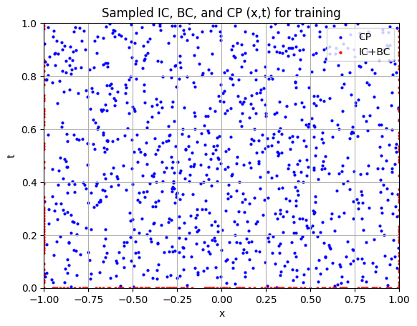
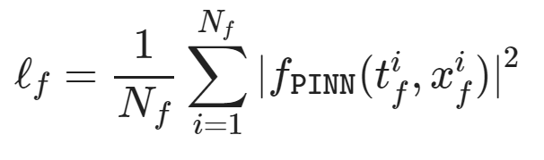
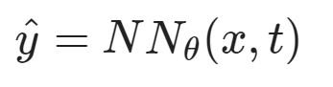
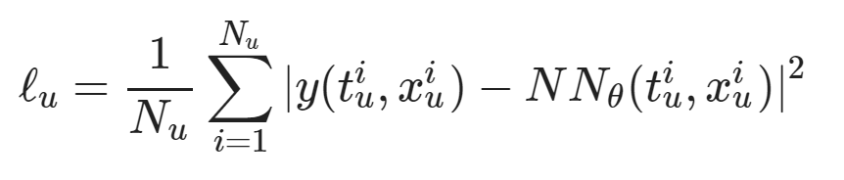
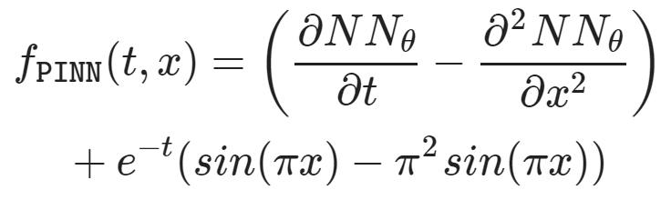
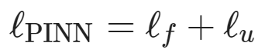
Components of Physics-Informed Neural Networks
Dataset: collocation points in the spatio-temporal coordinates.
Architecture: PDE equations solved with neural network via automatic differentiation.
Loss function: minimizing PDE equation, initial and boundary condition residuals.
https://github.com/pnnl/neuromancer/blob/master/examples/PDEs/Part_2_PINN_BurgersEquation.ipynb
M. Raissi, et al., Physics-informed neural networks: A deep learning framework for solving forward and inverse problems involving nonlinear partial differential equations, Journal of Computational Physics, 2019

Slide 6
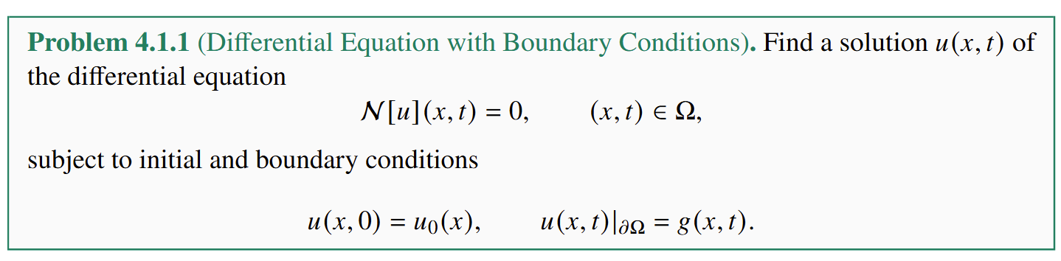
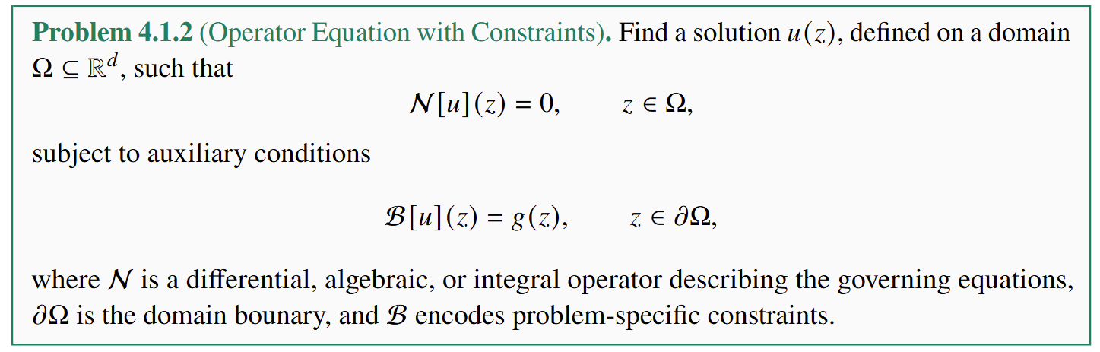
PINN Problem Formulation

Slide 7
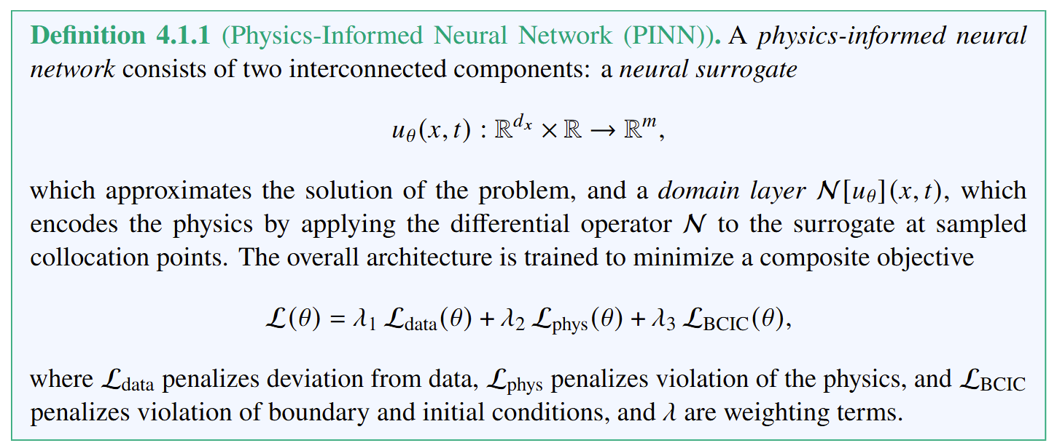
PINN Definition

Slide 8
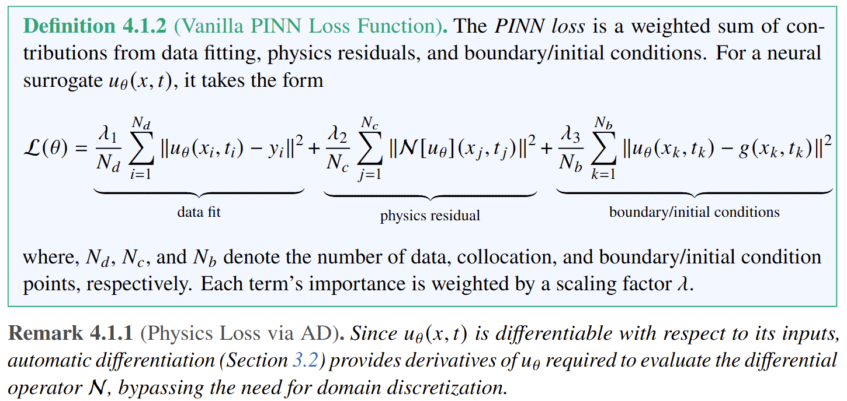
PINN Loss Function

Slide 9
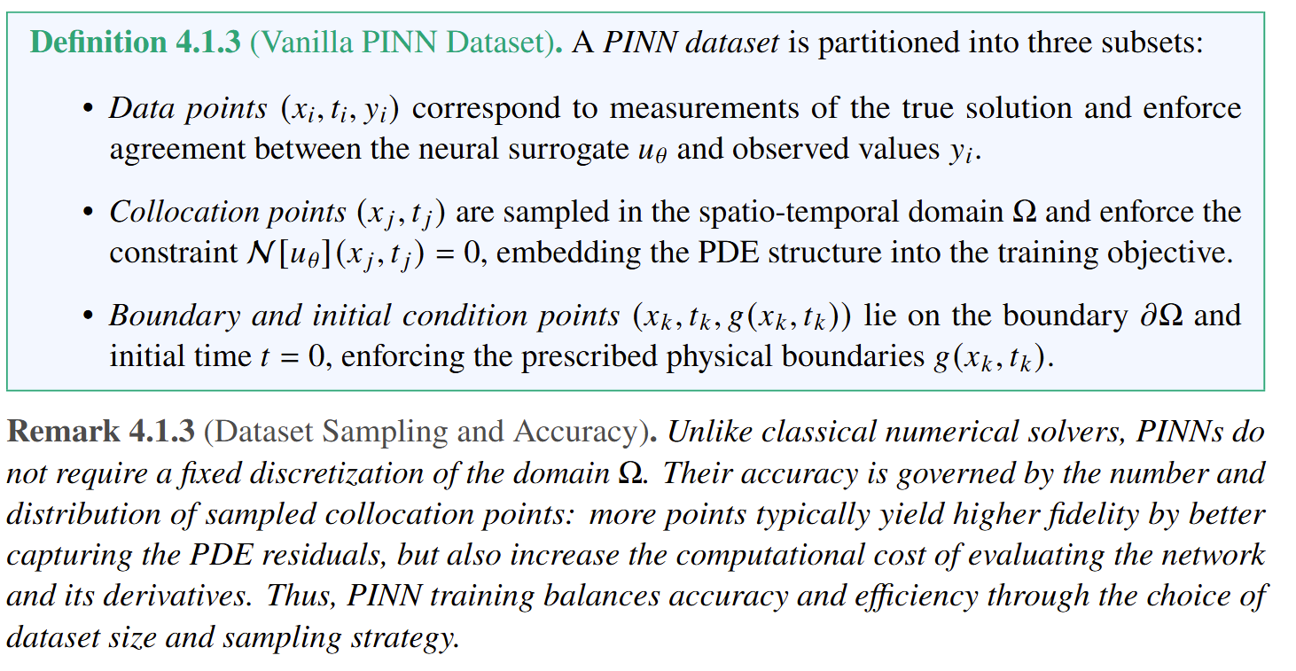
PINN Dataset

Slide 10
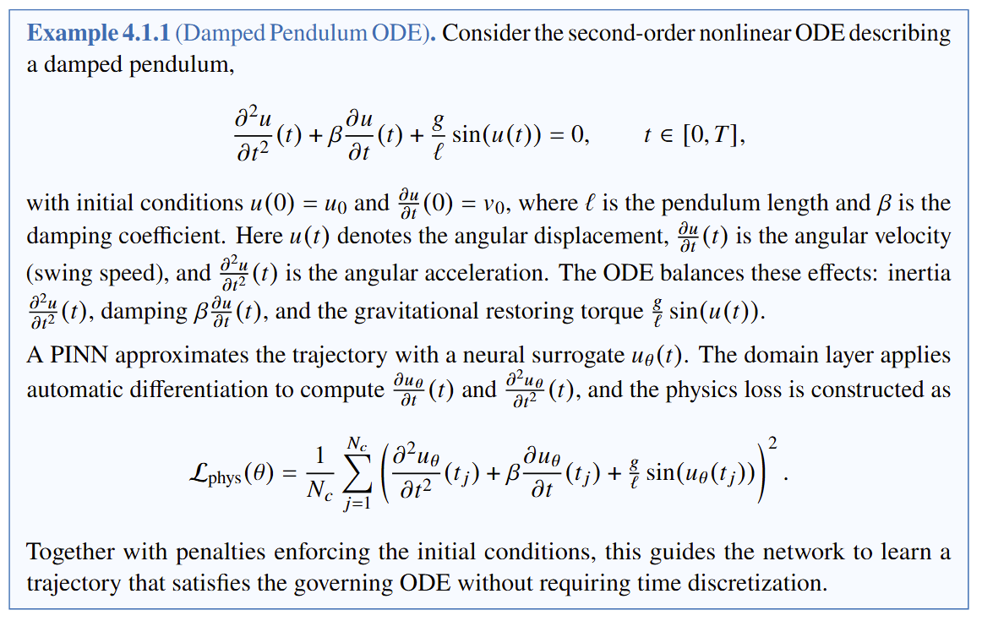
PINN Forward ODE Example

Slide 11
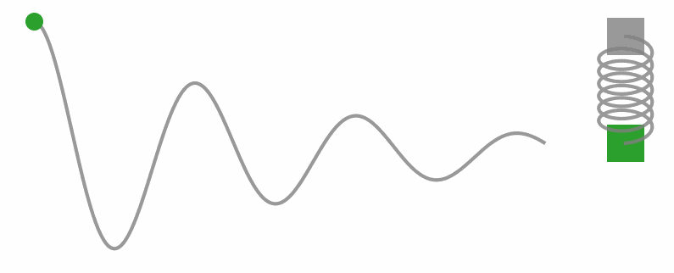
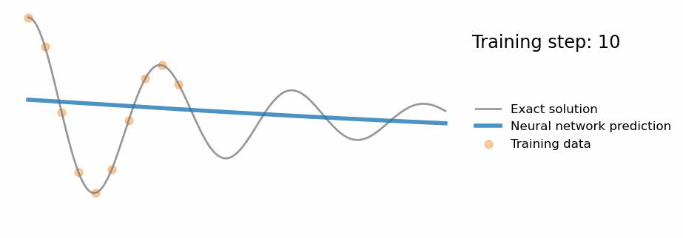
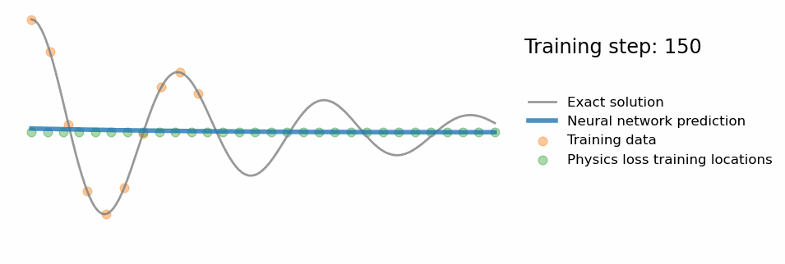
PINN Forward ODE Example
Damped pendulum dynamics:
Supervised neural network training:
PINN training:
https://benmoseley.blog/my-research/so-what-is-a-physics-informed-neural-network/

Slide 12
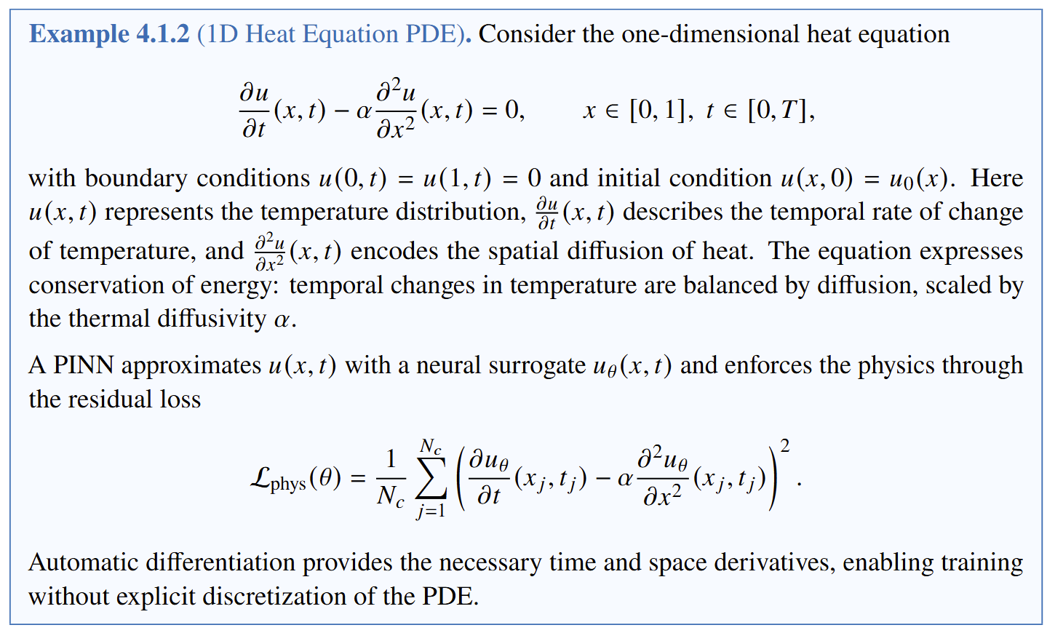
PINN Forward PDE Example

Slide 13
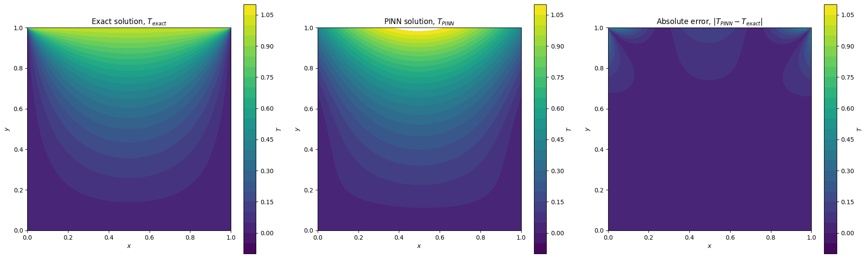
PINN Forward PDE Example
Comparison of exact solution vs PINN solution on 1D heat equation PDE example.
https://colab.research.google.com/github/pnnl/neuromancer/blob/master/examples/PDEs/Part_4_PINN_LaplaceEquationSteadyState.ipynb

Slide 14
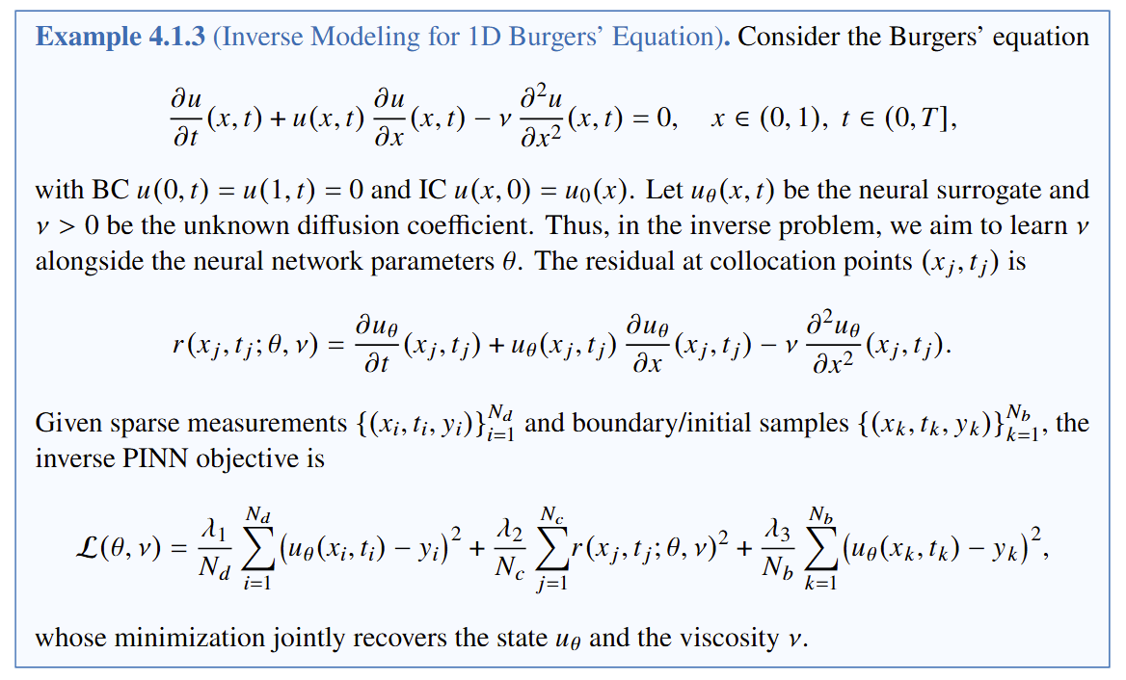
PINN Inverse PDE Example

Slide 15
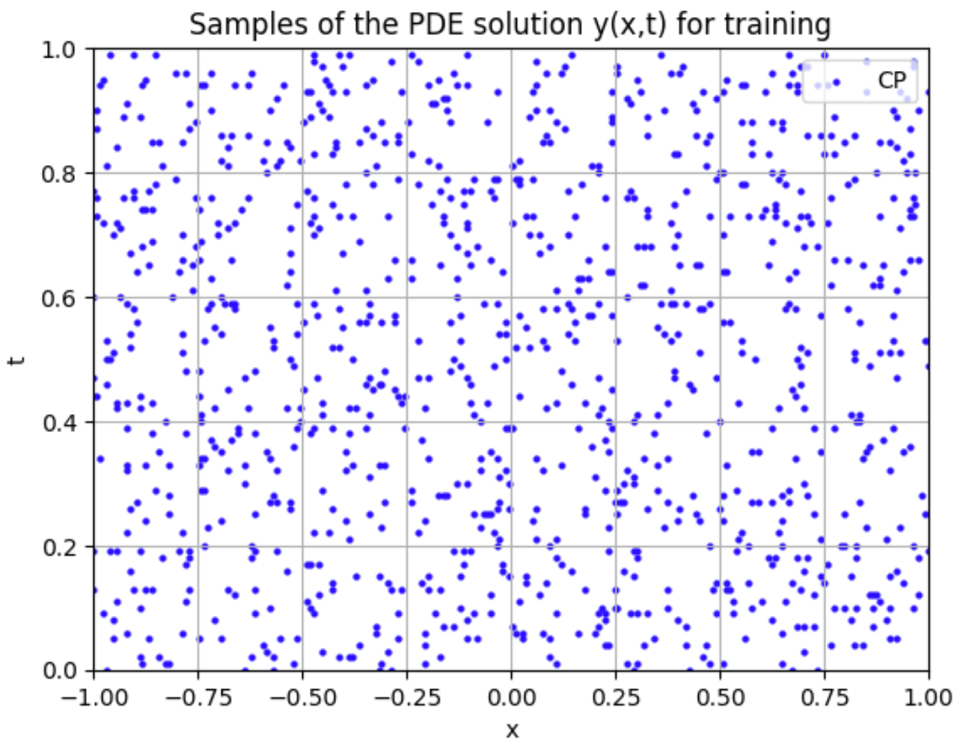
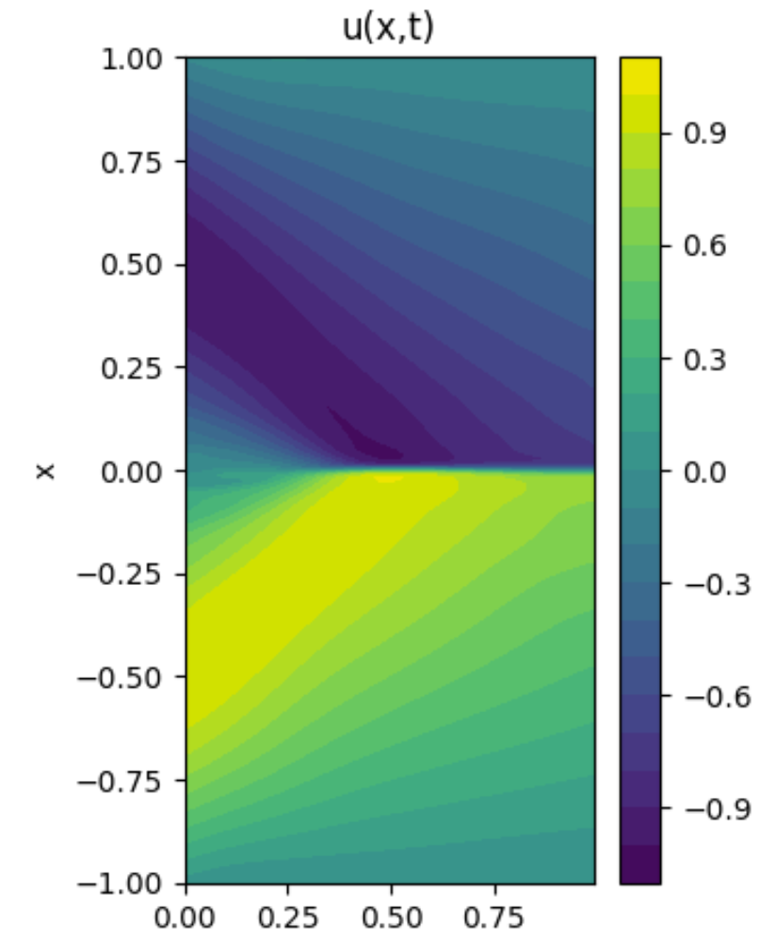
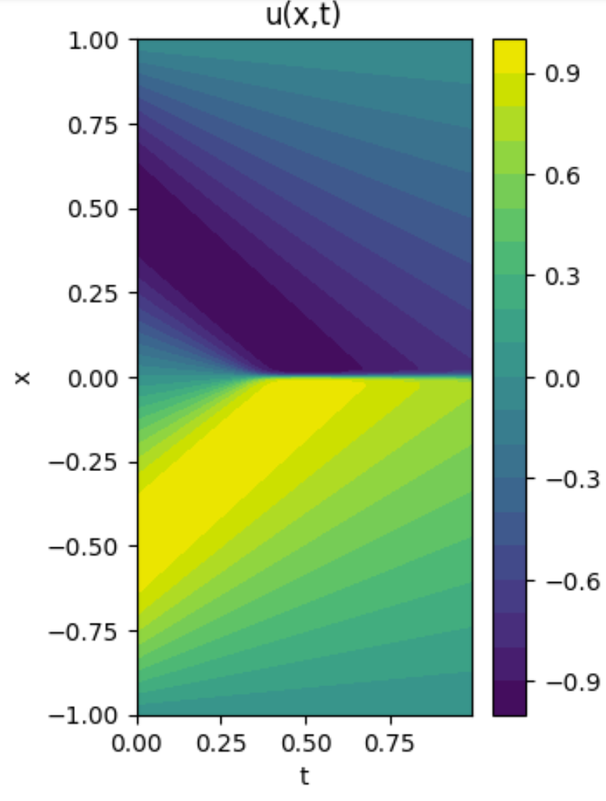
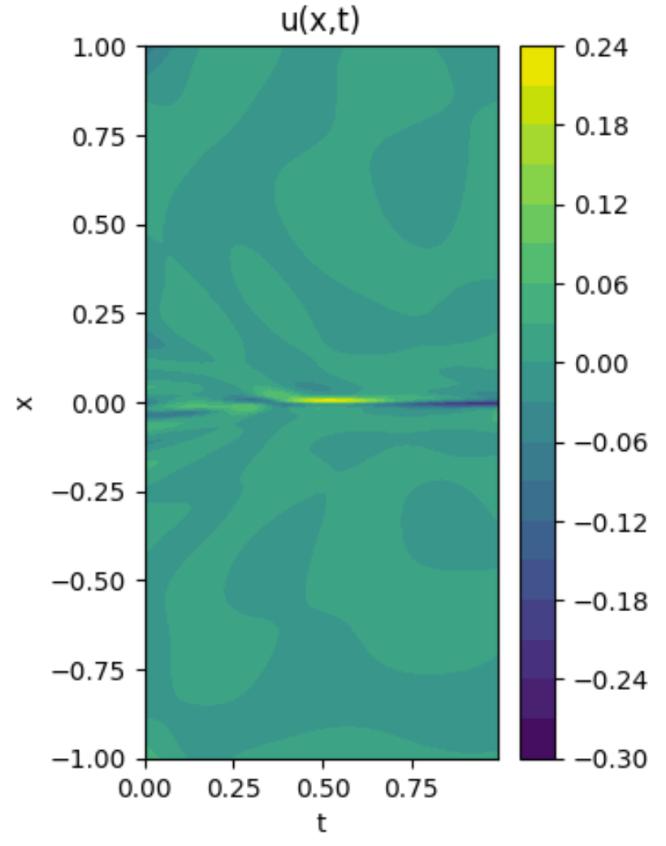
PINN Inverse PDE Example
Parameter estimation of a PDE from sparse measurement data with PINNs.
measurements
true PDE
PINN solution
PINN error
https://colab.research.google.com/github/pnnl/neuromancer/blob/master/examples/PDEs/Part_3_PINN_BurgersEquation_inverse.ipynb

Slide 16
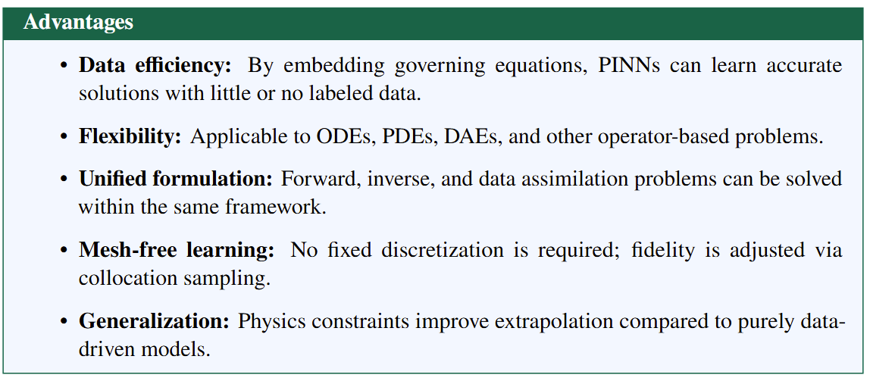
PINNs Advantages

Slide 17
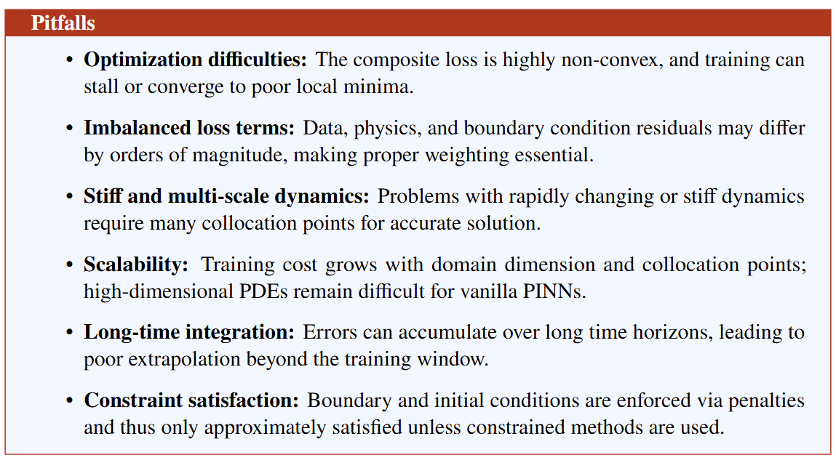
PINNs Challenges

Slide 18


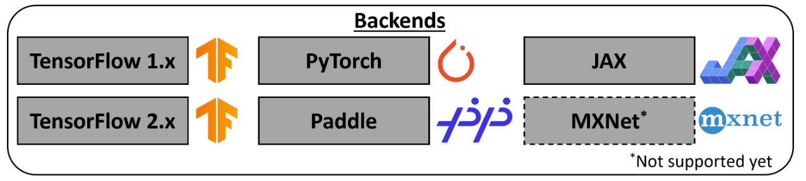

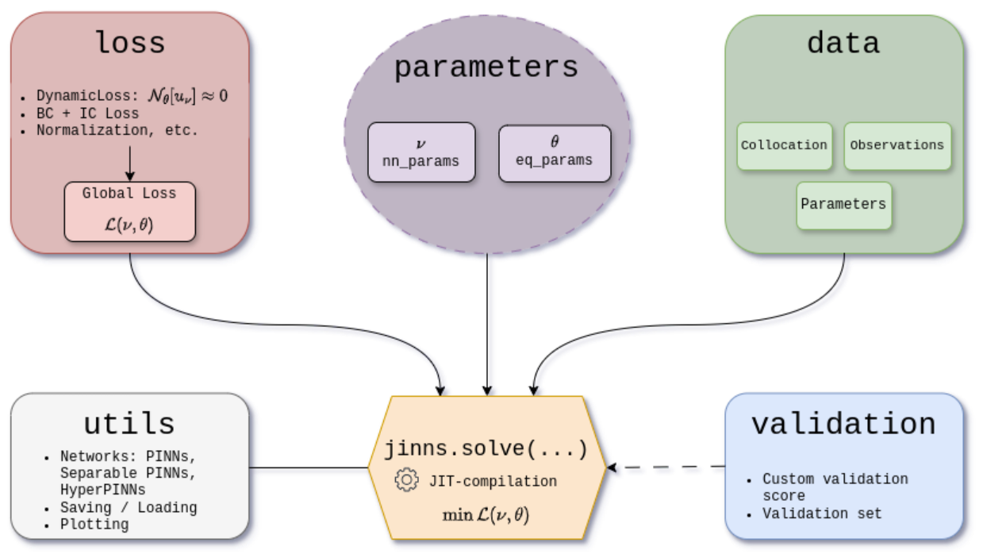
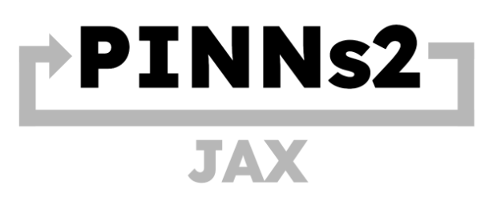
PINN Open-Source Software Libraries
DeepXDE
github.com/lululxvi/deepxde
docs.sciml.ai/NeuralPDE/stable/
github.com/pnnl/neuromancer
github.com/rezaakb/pinns-jax
github.com/mia-jinns/jinns
developer.nvidia.com/physicsnemo

Slide 19

PINNs in NeuroMANCER Scientific Machine Learning Library
PINN Examples
Diffusion Equation
Burgers' Equation
Burgers' Equation w/ Parameter Estimation (Inverse Problem)
Laplace's Equation (steady-state)
Damped Pendulum via stacked PINN
Navier-Stokes equation (lid-driven cavity flow, steady-state, KAN)
github.com/pnnl/neuromancer

Slide 20
References
Historical references
Psichogios, D. C. and L. Ungar (1992). “A hybrid neural network–first principles approach to process modeling”. In: AIChE Journal
Dissanayake, M. and N. Phan-Thien (1994). “Neural-network-based approximations for solving partial differential equations”. In: Communications in Numerical Methods in Engineering
Lagaris, I. E., A. Likas, and D. I. Fotiadis (1998). “Artificial neural networks for solving ordinary and partial differential equations”. In: IEEE Transactions on Neural Networks
Modern PINN papers
M. Raissi, et al., (2019). Physics-informed neural networks: A deep learning framework for solving forward and inverse problems involving nonlinear partial differential equations, Journal of Computational Physics
Berg, J. and K. Nyström (2018). A unified deep artificial neural network approach to partial differential equations in complex geometries. Neurocomputing
Karniadakis, G.E., Kevrekidis, I.G., Lu, L. et al. (2021) Physics-informed machine learning. Nat Rev Phys 3
Advanced PINN methods
Jagtap, A. D. and G. E. Karniadakis (2020). “Extended physics-informed neural networks (xpinns):A generalized space-time domain decomposition based deep learning framework for nonlinear partial differential equations”. In: Communications in Computational Physics
Kharazmi, E., Z. Zhang, and G. E. Karniadakis (2021). “hp-VPINNs: Variational physics-informed neural networks with domain decomposition”. In: Computer Methods in Applied Mechanics and Engineering
Krishnapriyan, A. S., A. Gholami, S. Zhe, R. Kirby, and M. W. Mahoney (2021). “Characterizing possible failure modes in physics-informed neural networks”. In: Advances in Neural Information Processing Systems
Wang, S., Y. Teng, and P. Perdikaris (2021). “Understanding and Mitigating Gradient Flow Pathologies in Physics-Informed Neural Networks”. In: SIAM Journal on Scientific Computing
Wang, S., X. Yu, and P. Perdikaris (2022). “When and why PINNs fail to train: A neural tangent kernel perspective”. Journal of Computational Physics
McClenny, L. D. and U. M. Braga-Neto (2023). “Self-adaptive physics-informed neural networks”. Journal of Computational Physics
Son, H., S. Cho, and H. Hwang (2023). Enhanced physics-informed neural networks with Augmented Lagrangian relaxation method. Neurocomputing
Wang, S., S. Sankaran, P. Stinis, and P. Perdikaris (2025). Simulating Three-dimensional Turbulence with Physics-informed Neural Networks. arXiv: 2507.08972.

Slide 21
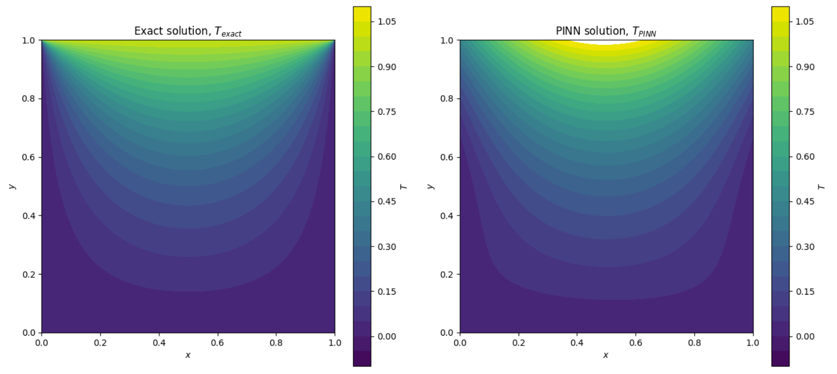
In-class Exercises
Exercise 1: Implement the PINN example with damped pendulum ODE dynamics from scratch.
Exercise 2: Implement the PINN example with 1D PDE heat equation from scratch.

Slide 22
Homework
HW1: Compare PINN solution of a selected nonlinear ODE with traditional numerical method (e.g. RK4).
Submit as single .py or .ipynb jupyter nobetook file that includes the code, markup description, and figures comparing two solutions and quantifies the solution error.
HW2 (Optional): Do the same as in HW2 for selected PDE other than heat equation.
Submit as single .py or .ipynb file that compares two solutions and quantifies the solution error.

Slide 23
Week 11: Project Presentations and Evaluation
Projects cover 70% of the course grade!
Project proposal 20% - week 5
Project progress report 10% - week 8
Project final report 20% - week 10
Project presentation 20% - week 11
Project format.
Project technical report: 4 to 6 page long pdf document including references and figures.
Project presentation: ppt or pdf slides, 15 min time slot per student in week 11.
Admissible topics.
Application of selected SciML methods to problems inspired by real-world applications
e.g., L2O for large scale optimization of energy systems.
Development of new methods tackling some of the open challenges in SciML
e.g., novel way of utilizing PINNs in differentiable control for PDEs.
New theory supporting selected SciML methodology
e.g., convergence analysis of feasibility restoration layers in L2O.

